Slide 1


Economic Benefits of Accessible
Transport
November 2025
Insights Report

Slide 2


About ncat
ncat is delivered by a consortium of organisations that includes Coventry University, Policy Connect, The Research Institute for Disabled Consumers (RiDC), Designability, Connected Places Catapult, and WSP.
ncat is funded by the Motability Foundation, with the aim of providing the evidence base to make transport more accessible.
For more information about ncat and its work please visit our website www.ncat.uk
To contact ncat, either about this report or any other query, please email info@ncat.uk
The National Centre for Accessible Transport (ncat) works as an Evidence Centre developing high quality evidence, best practice and innovative solutions to inform future disability and transport strategy, policy, and practice by:
Engaging with disabled people to better understand their experiences and co-design solutions
Amplifying the voices of disabled people in all decision making
Collaborating widely with all transport stakeholders
Demonstrating good practice and impact to influence policy

Slide 3
Why did we do this work?
Our ncat research ‘Working together for accessible transport’ found:
Securing investment for accessibility improvements remains a major challenge. Key barriers include:
Accessibility improvements can be seen as too expensive and difficult to justify.
Economic benefits and social value are often misunderstood.
What are the objectives of this research project?
This project aimed to:
Understand challenges and barriers in securing funding.
Provide recommendations to facilitate investment in accessible transport.
Identify responsible stakeholders for change.
Disabled people feel transport is not accessible and most believe this won’t change in the next 10 years (ncat, 2024).
Our ncat research ‘Understanding and identifying barriers to accessing transport’ found:
79% of disabled people travel less often because transport feels inaccessible and unreliable.
84% experience longer journeys due to barriers like poor connections and lack of step-free access.
75% feel stressed when travelling because of uncertainty and inadequate support.

Slide 4
What did we do?
Our research was structured in two key phases to understand funding challenges and propose actionable solutions.
During engagement, we explored processes, appraisal methods, and views on unlocking funding. Based on the findings from both the desktop and the stakeholder engagement, we created a series of conclusions on the key barriers that public sector organisations face when creating business cases for investment in accessibility related schemes.
Phase 2: Recommendation
This phase aimed to develop practical solutions for the challenges and barriers identified during Phase 1. We drafted recommendations by theme and assigned ownership. We facilitated a follow-up workshop with 10 participants from 9 organisations to validate and refine our findings and recommendations. Feedback was used to finalise our recommendations and develop the research report.
Phase 1: Discovery
This phase focused on identifying barriers through, a desktop review of funding lifecycle and appraisal guidance, including:
HM Treasury Green Book (2022 & Review 2025)
Department for Transport Transport Business Guidance, Transport Appraisal Guidance (TAG) and Value for Money (VfM) framework
Policy papers, charity reports, academic studies
We also undertook stakeholder engagement with 9 organisations interviewed (public sector, government agencies, transport bodies, charity).

Slide 5
What did we find from the desktop review?
The main findings from the desktop review of the funding lifecycle and appraisal guidance are summarised below, more detail is provided on following pages.
Finding 4: Limited data on accessibility challenges undermines understanding of the real impacts of inaccessibility and weakens evidence for decision-making.
Finding 5: Existing appraisal methods undervalue accessibility benefits, meaning social and quality-of-life improvements are often overlooked in funding decisions.
Finding 6: Accessibility schemes typically score poorly on Value for Money assessments due to reliance on Benefit-Cost Ratios that favour easily monetised impacts.
Finding 7: Lack of transparency in business cases makes it hard to learn from previous projects and share best practice across the sector.
Finding 8: Forthcoming Green Book updates could improve the appraisal of accessibility schemes if reforms are implemented effectively and consistently.
Finding 1: There aren’t any current dedicated funds for accessibility related improvements, resulting in conflicting priorities between transport schemes and objectives.
Finding 2: Elements of the Treasury’s Five Case Model create barriers for accessibility schemes because benefits are hard to quantify and justify within the current framework.
Finding 3: The process to secure public sector funding is long, slow, and highly structured, making it difficult for smaller accessibility projects to progress quickly.

Slide 6

What did we find from the desktop review? (Finding 1)
Finding 1: There aren’t any current dedicated funds for accessibility related improvements, resulting in conflicting priorities between transport schemes and objectives.
There is no dedicated, binding funding for accessibility in UK transport, meaning projects compete with other priorities like congestion reduction and economic growth. Past schemes such as Access for All improved rail station access but ended in 2024, leaving future funding uncertain.
Accessibility now relies on broader transport funds, making it vulnerable to cuts. While the Government promises to prioritise accessibility in the upcoming Integrated National Transport Strategy, delivery depends on clear action plans and sustained investment.

Slide 7
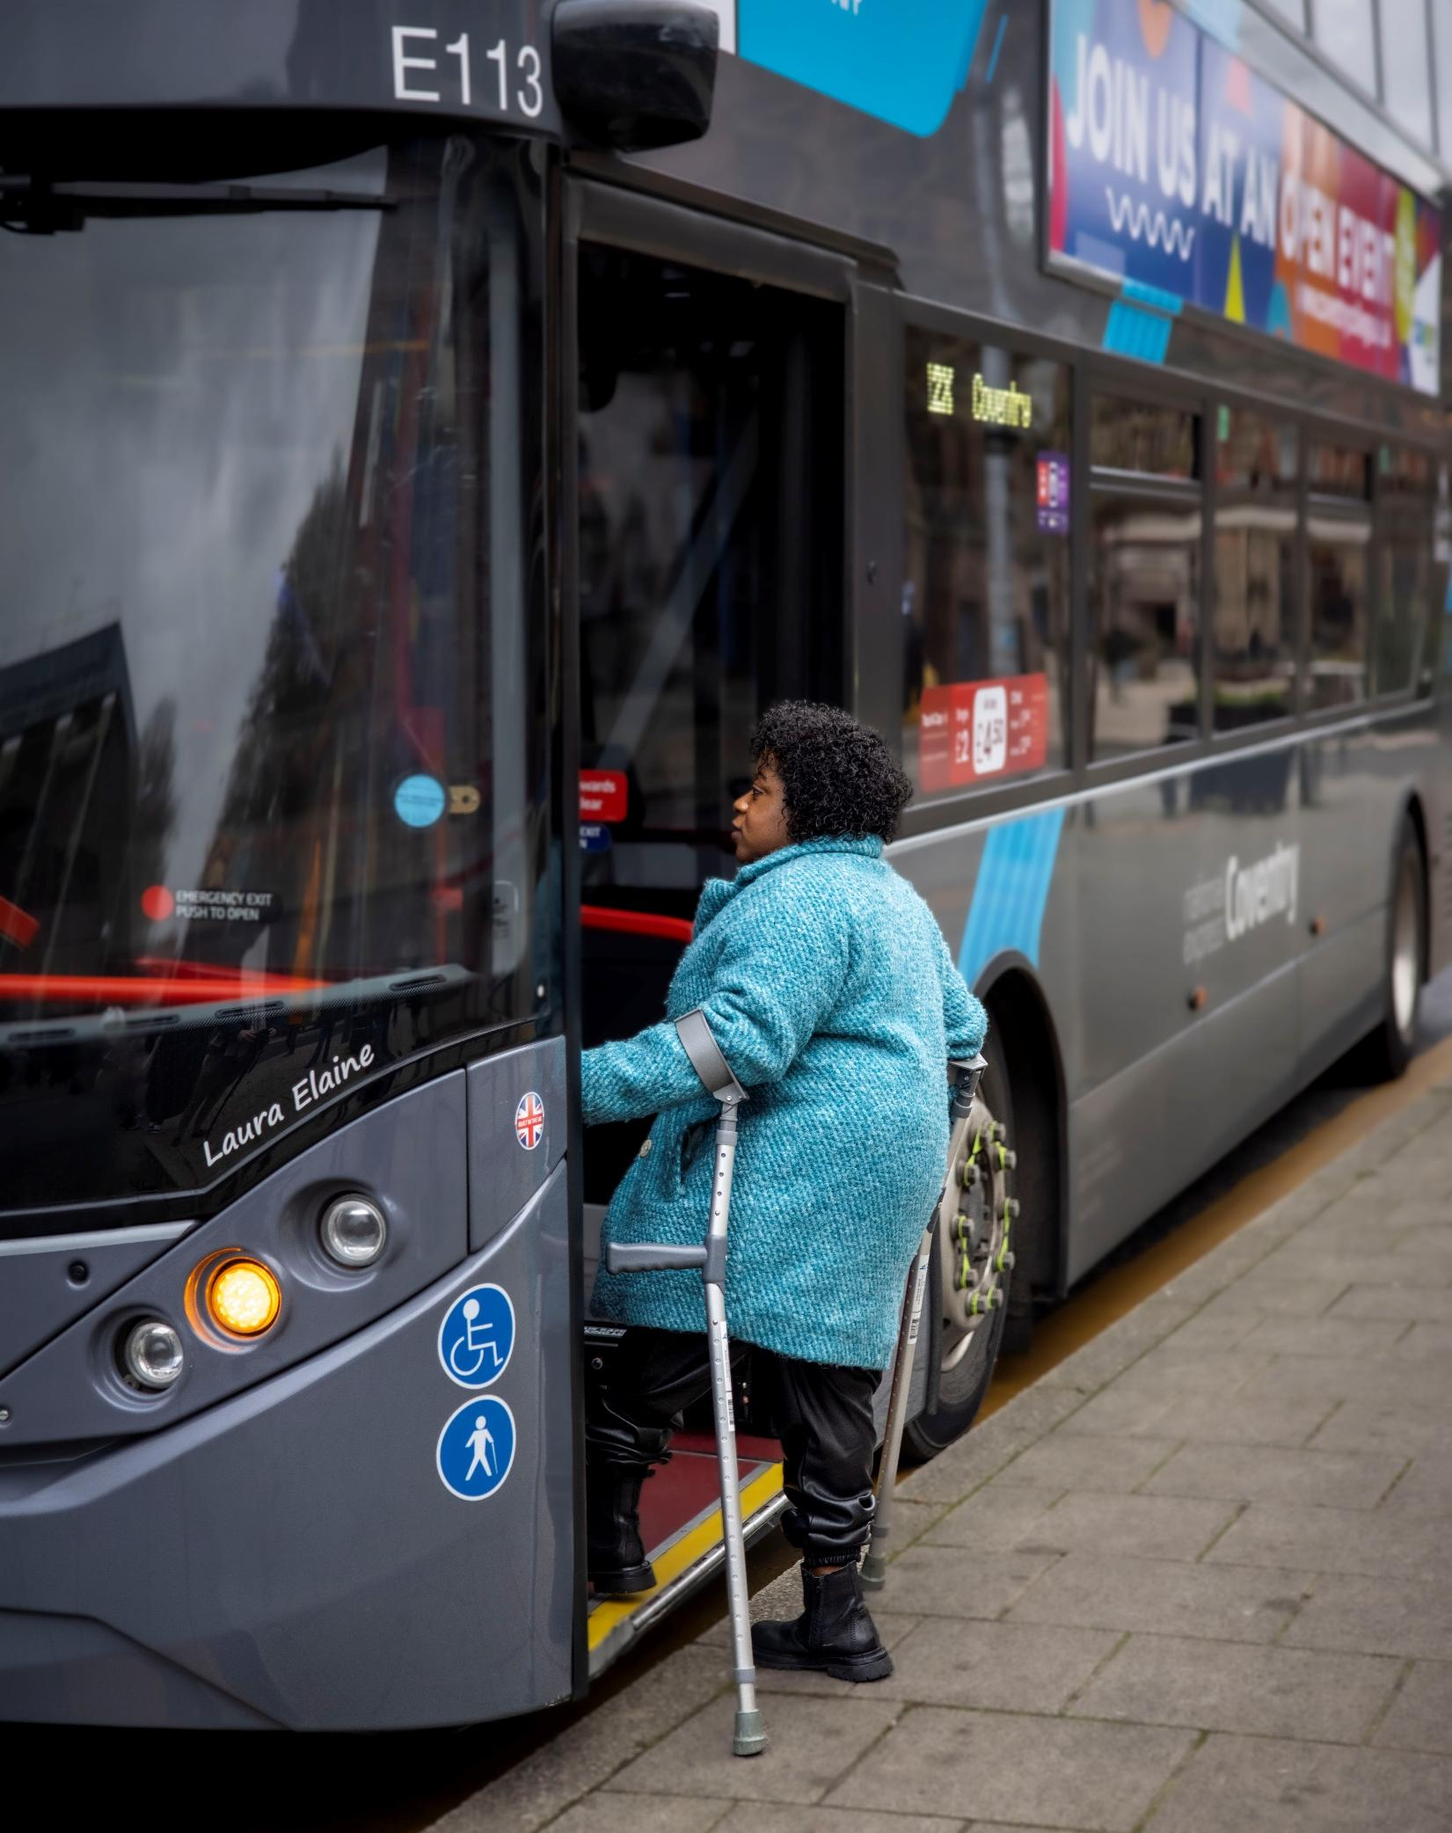
What did we find from the desktop review? (Finding 2)
Finding 2: Elements of the Treasury’s Five Case Model create barriers for accessibility schemes because benefits are hard to quantify and justify within the current framework.
The Treasury’s Five Case Model may inadvertently disadvantage accessibility schemes seeking funding because its structure doesn’t capture social benefits like independence or equity in monetary terms, leading to poor Value for Money scores. Limited data weakens the strategic case, while high upfront costs and reliance on small funds undermine affordability. Commercial and management dimensions add further hurdles through complex procurement, bespoke technologies, and perceived delivery risks, making accessibility projects harder to justify and secure funding.

Slide 8

What did we find from the desktop review? (Finding 3)
Finding 3: The process to secure public sector funding is long, slow, and highly structured, making it difficult for smaller accessibility projects to progress quickly.
Transport projects seeking funding must progress through option development, business case preparation under the Five Case Model, assurance, and final approval. The business case evolves from a Strategic Outline Case to an Outline Business Case and then a Full Business Case, a process that typically takes 2–4 years for standard projects and up to a decade for major schemes. While this approach ensures accountability, it can be slow and resource-heavy, including for accessibility focused schemes. It is noted that existing Green Book guidance recommends proportional flexibility for less complex projects.

Slide 9


What did we find from the desktop review? (Finding 4)
Finding 4: Limited data on accessibility challenges undermines understanding of the real impacts of inaccessibility and weakens evidence for decision-making.
There is a major data gap on disabled travellers’ experiences and needs, with official transport statistics failing to capture key indicators such as inability to travel, assistance failures, or real-time infrastructure outages. Existing datasets lack granularity by disability type, severity, and intersectional factors, making barriers invisible and solutions poorly targeted. Without robust quantitative and qualitative data, accessibility issues are often excluded from early planning stages, treated as optional, and lack the evidence needed to build strong business cases.

Slide 10
What did we find from the desktop review? (Finding 5)
Traditional approaches group people into broad categories and only consider disabled people later in distributional assessments, limiting visibility of their needs. This disconnect means accessibility benefits rarely influence the core economic case, even though they can generate measurable outcomes such as increased travel and revenue, better journey experiences, improved quality of life, and greater economic activity. These benefits are monetisable, yet they are not systematically captured, resulting in underrepresentation of accessibility in business cases.
Disabled people and their households have an estimated £274 billion annual spending power in the UK, known as the Purple Pound. Better accessibility unlocks this demand by enabling more frequent travel, boosting fare revenue and local economies. Reducing isolation through improved transport access drives spending and growth. This strengthens the case for accessibility schemes and calls for clearer guidance, earlier monetisation, and stronger policy. Without reform, accessibility will remain undervalued despite its proven impact.
Finding 5: Existing appraisal methods undervalue accessibility benefits, meaning social and quality-of-life improvements are often overlooked in funding decisions.
Current appraisal methods for transport schemes undervalue accessibility benefits because they lack robust ways to monetise improvements in independence, inclusion, and quality of life. While some benefits such as journey time savings or improved journey quality can be monetised using existing tools, these methods are inconsistently applied. Other impacts, like step-free access or perceived safety, are treated qualitatively and often overlooked in funding decisions.

Slide 11
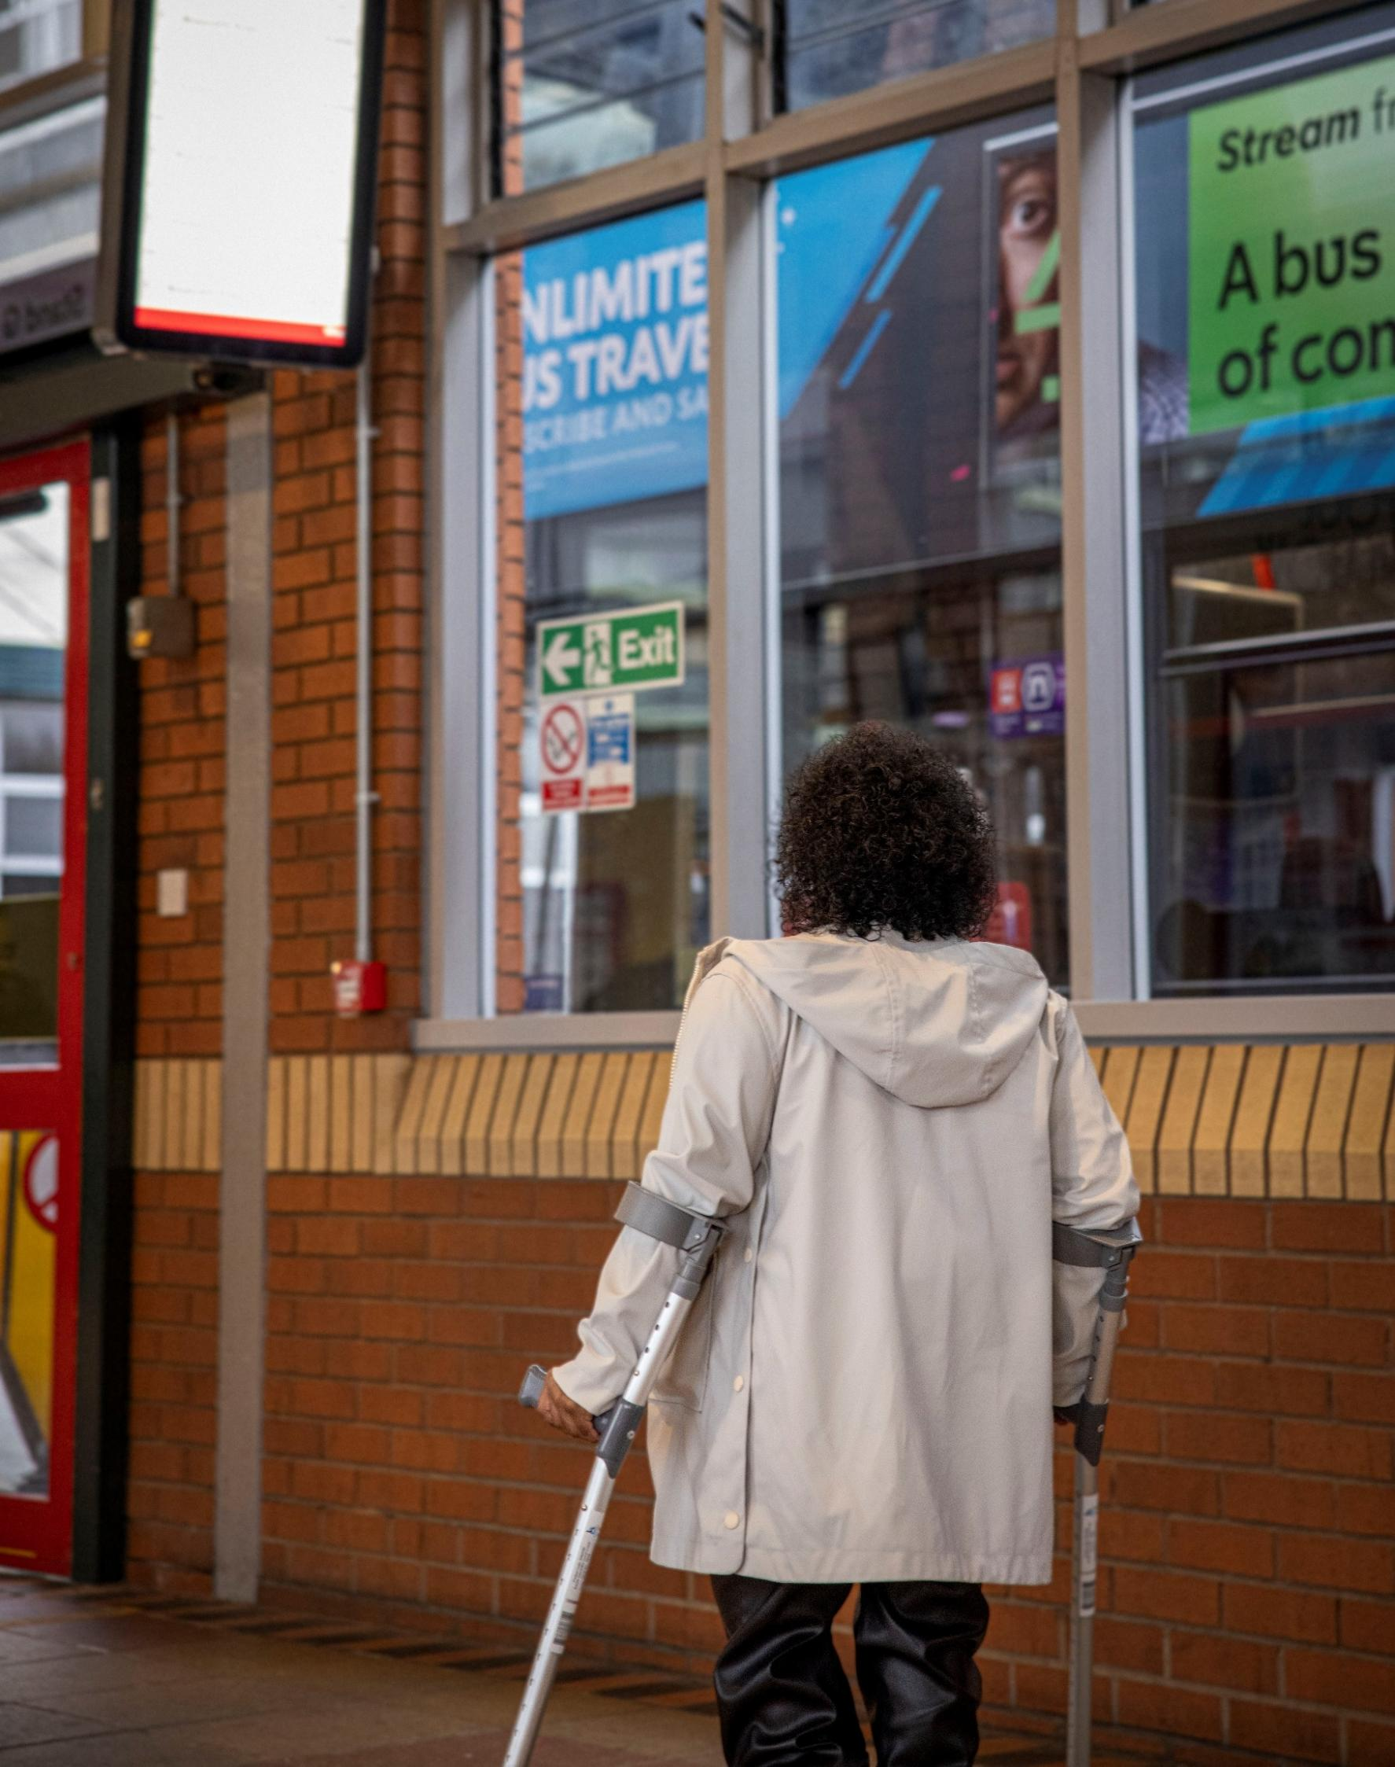
What did we find from the desktop review? (Finding 6)
Finding 6: Accessibility schemes typically score poorly on Value for Money assessments due to reliance on Benefit-Cost Ratios that favour easily monetised impacts.
Accessibility schemes often score poorly on VfM because the DfT framework prioritises monetised impacts like time savings and vehicle costs, while social benefits remain hard to quantify. Although indicative impacts can now be included in benefit-cost ratio (BCR) calculations, decision-making still leans heavily on easily measured benefits, disadvantaging projects with qualitative outcomes. Academic research confirms these limitations, stressing that accessibility benefits, though significant, are undervalued, making schemes less competitive against projects with higher BCRs.

Slide 12
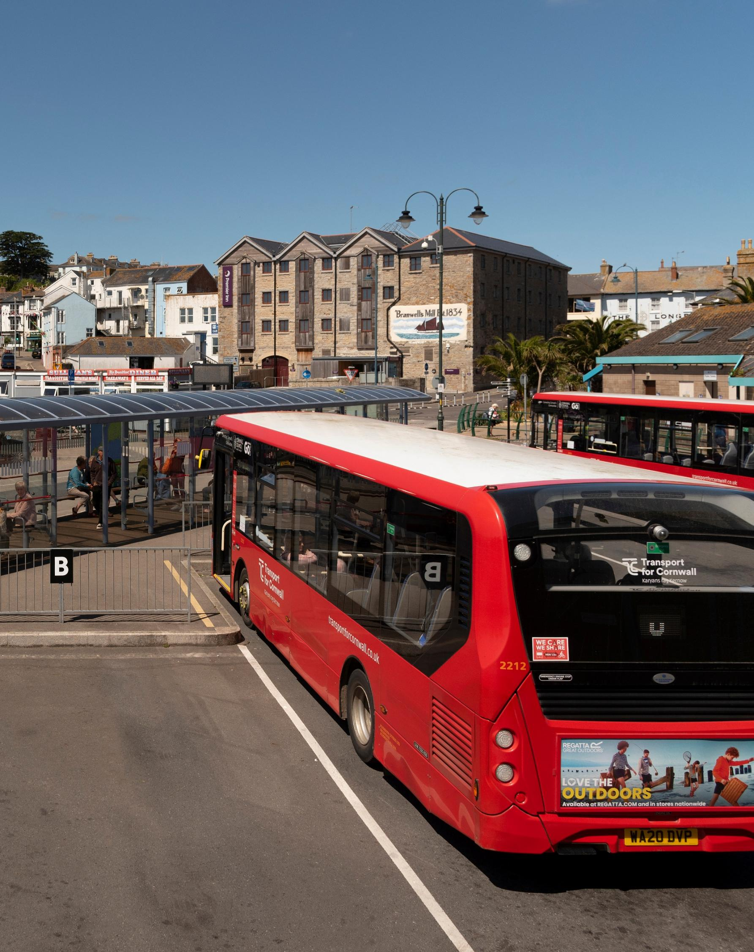
What did we find from the desktop review? (Finding 7)
Finding 7: Lack of transparency in business cases makes it hard to learn from previous projects and share best practice across the sector.
Accessibility schemes suffer from poor transparency because business cases have historically not been published, limiting learning and best practice. Although major projects must now publish cases within four months of HM Treasury approval (as of June 2025), this excludes smaller schemes where accessibility improvements often sit.
Limited evaluation frameworks and absence of robust accessibility metrics further hinder evidence-based decision-making. Greater transparency and integrated accessibility indicators are essential to improve appraisal quality and outcomes.

Slide 13

What did we find from the desktop review? (Finding 8)
Finding 8: Forthcoming Green Book updates could improve the appraisal of accessibility schemes if reforms are implemented effectively and consistently.
The forthcoming Green Book update (due 2026) could improve accessibility investment by simplifying guidance, promoting place-based business cases, and better assessing long-term transformational benefits. Proposed changes include clearer treatment of non-monetised social benefits, reducing reliance on BCR thresholds, and improving transparency through published business cases. Enhanced training and early-stage support via the National Wealth Fund aim to build capability for stronger local business cases. If fully implemented, these reforms could help accessibility schemes overcome some of the current barriers.

Slide 14
What did we find from the stakeholder engagement?
The main findings from the stakeholder engagement are summarised below, more detail is provided on following pages.
Finding 1: There isn’t enough expertise and dedicated resource in organisations to develop accessibility related business cases.
Finding 2: Lack of leadership commitment and dedicated policies often hold back the prioritisation of accessibility related schemes.
Finding 3: Limited and outdated evidence and data on the economic and social benefits of accessibility related improvements make it difficult to justify investment.
Finding 4: There is an overemphasis on BCR and VfM in funding decisions and under-reliance on wider social value.
Finding 5: The funding process for accessibility schemes is slow, uncertain, and expensive, discouraging organisations from starting business case development.
Finding 6: Inconsistency in the timing and depth of engagement with disabled people leads to variability in how lived experience is incorporated into business cases.

Slide 15

What did we find from the stakeholder engagement? (Finding 1)
Finding 1: There isn’t enough expertise and dedicated resource in organisations to develop accessibility related business cases.
Organisations may lack the dedicated expertise, resource, and structured processes needed to develop strong accessibility focused business cases. Responsibilities are often fragmented across mode-specific teams, leading to inconsistent approaches and limited sharing of lessons learned. Training on accessibility appraisal is rare, and there is no standardised framework, leaving teams ill-equipped to embed accessibility from the outset. These gaps result in inconsistent stakeholder engagement and weak integration of lived experience into business cases.

Slide 16

Quote from research participant
“In terms of training for appraisal of accessibility, I don't think I've ever had any [...] I'm not aware of any specific learning.”
Research participant

Slide 17

What did we find from the stakeholder engagement? (Finding 2)
Finding 2: Lack of leadership commitment and dedicated policies often hold back the prioritisation of accessibility related schemes.
Accessibility is rarely prioritised without strong leadership and clear organisational policies. Budget pressures can lead to accessible features being cut from transport projects, and competing priorities dilute business case clarity. Some organisations adopt a “minimum viable product” mindset around accessibility, which means it is introduced late in the business case process, limiting co-design opportunities. In many cases, issues are only addressed reactively after complaints, which is typically more expensive than embedding accessibility from the outset, reflecting a lack of high-level oversight across all projects.

Slide 18

What did we find from the stakeholder engagement? (Finding 3)
Finding 3: Limited and outdated evidence and data on the economic and social benefits of accessibility related improvements make it difficult to justify investment.
A major barrier to justifying investment in accessibility is the absence of robust, up-to-date data. Baseline information on accessibility infrastructure and disaggregated data for disabled populations is often missing or too small to be meaningful, making it hard to quantify benefits or track outcomes. Business cases rely heavily on qualitative evidence, which is seen as less robust, and monitoring of accessibility impacts is rare. Without accurate data and evaluation, benefits remain underrepresented.

Slide 19

What did we find from the stakeholder engagement? (Finding 4)
Finding 4: There is an overemphasis on BCR and VfM in funding decisions and under-reliance on wider social value.
Funding decisions often rely on BCR and VfM metrics, which disadvantage accessibility schemes that deliver social rather than monetised benefits. Existing appraisal tools lack clear guidance for valuing non-financial outcomes. In the absence of clear guidance, some stakeholders have developed their own bespoke methods to capture these benefits, highlighting the need for a consistent, sector-wide framework.
Stakeholders called for robust, sector-wide frameworks to better reflect the full value of accessible transport.

Slide 20

What did we find from the stakeholder engagement? (Finding 5)
Finding 5: The funding process for accessibility schemes is slow, uncertain, and expensive, discouraging organisations from starting business case development.
Securing public sector funding for accessibility schemes is often slow, uncertain, and costly. The lack of early confidence in approval or availability of dedicated funding can discourage organisations from starting business cases, while strict criteria and high preparation costs can be disproportionate to the scale of interventions.
Shifting political priorities and scrutiny over economic justification can further delay or stall projects, making accessibility proposals vulnerable to being deprioritised.

Slide 21
Quote from a research participant
“It's the first thing people look for in a business case, isn't it? The BCR. So even if it's something that we're not meant to be focusing on, if that's going to continue to be the trend.”
Research participant

Slide 22
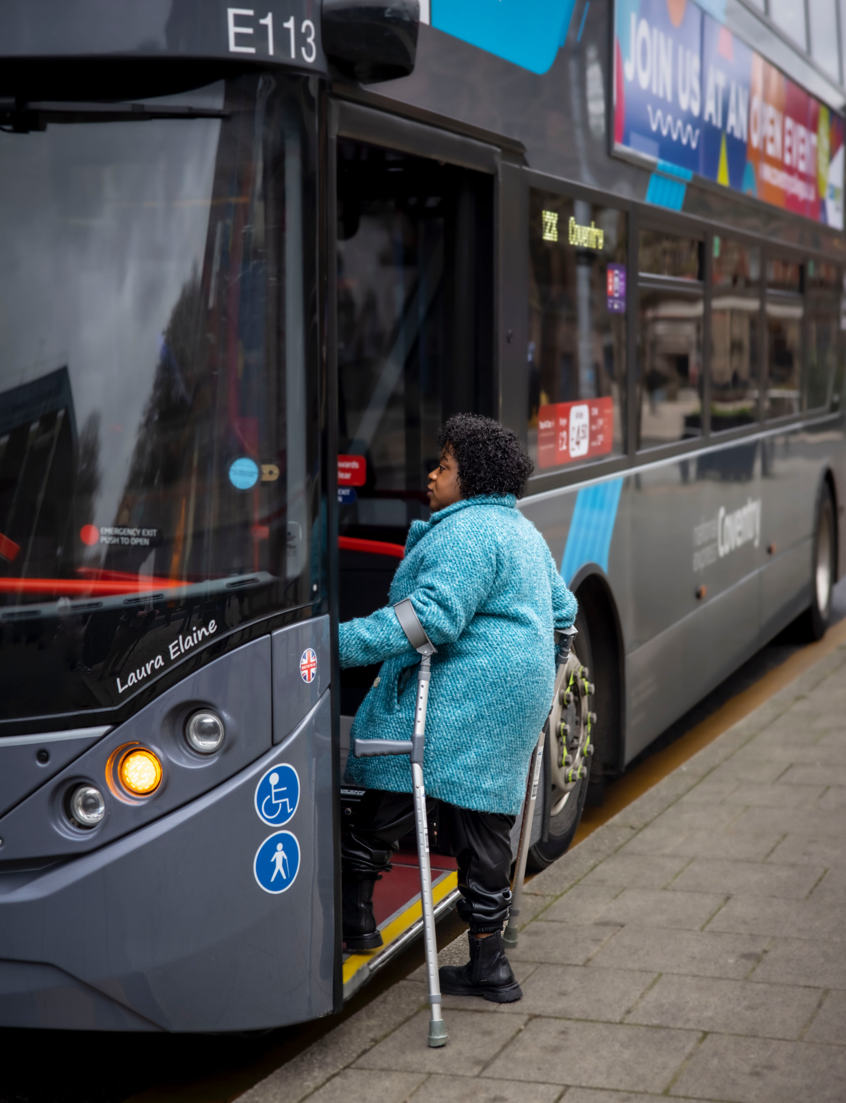
What did we find from the stakeholder engagement? (Finding 6)
Finding 6: Inconsistency in the timing and depth of engagement with disabled people leads to variability in how lived experience is incorporated into business cases.
Disabled people are often engaged too late in the business case process, typically after key decisions are made, limiting opportunities for meaningful co-design. Engagement approaches vary widely, and feedback often comes from a small recurring group, risking consultation fatigue and lack of diversity. Without clear guidance, dedicated resources, or training, engagement can become a tick-box exercise, leaving accessibility considerations underrepresented in final business cases.

Slide 23
What conclusions did we come to?
The conclusions on key barriers that public sector organisations face when creating business cases for investment in accessibility related schemes are highlighted below.
Conclusion 3: The Government’s guidance documents and tools are not fit for purpose to support authorities in creating successful accessibility related business cases. This means staff rely on specialist know-how or their own custom tools to get around this challenge.
Conclusion 4: The overemphasis on the economic case is a key barrier to creating successful business cases for accessibility related schemes. Poor VfM scores and limited ways to incorporate social benefits are among the biggest challenges.
Conclusion 5: There are gaps in evidence and data on the economic and social benefits of accessibility related improvements. This is heightened by lack of transparency and knowledge sharing within and among authorities of data and best practices.
Conclusion 1: The lack of dedicated policies and funding pots makes it harder to invest in accessibility related improvements. Having to compete with other priorities for the same funding, means more effort and lower possibility of success.
Conclusion 2: Getting public sector funding is a long, structured and complex process, that requires specialist skills. Many authorities don’t have enough expertise and dedicated resources to carry out accessibility related business cases.

Slide 24

What should happen next?
This research found several barriers that authorities face in creating successful accessibility related business cases. Breaking down these barriers does not fall on a single organisation, rather the sector as a whole.
On the following pages, we outline a series of recommendations for the sector, clearly indicating whether each recommendation applies to public sector transport organisations, or to the Department for Transport (DfT) and wider government.

Slide 25

What should happen next? (Embedding accessibility)
Public sector transport organisations should:
Provide organisation-wide training on accessibility and inclusion, including leadership. Offer targeted training on appraising accessibility impacts and integrating lived experiences into business cases. Ensure sufficient staff with accessibility expertise and clear responsibilities and employ professionals with lived experience to embed inclusivity.
Equip business case teams with accessibility knowledge (and vice versa) and promote cross-team knowledge sharing.
DfT/Government should:
Develop dedicated training on appraising accessibility in business cases, engaging and incorporating disabled people’s lived experiences, and the updated Green Book guidance.
Update training materials as insights is gathered.
Recommendation 1: Embed accessibility in organisational culture through leadership, team diversity, general disability awareness training, and targeted business case development training.

Slide 26
What should happen next? (Policy into action)
Public sector transport organisations should:
Create stronger policies, strategies and action plans that include a clear focus on improving transport accessibility. Ensure Local Transport Plans contain a dedicated accessibility section.
DfT/Government should:
Establish a binding programme with enforceable mechanisms to compel authorities and operators to invest in accessibility within the upcoming Integrated National Transport Strategy.
Secure funding for accessibility by ringfencing funding for accessibility related projects to minimise competition with other priorities, OR prioritising accessibility related schemes for funding, OR conditioning funding on schemes that demonstrate accessibility improvements or inclusivity. If consolidated funding pots are being set up, accessibility should be explicitly considered within the pots.
Recommendation 2: Strengthen policies, strategies, action plans and create funding mechanisms that prioritise transport accessibility.

Slide 27
What should happen next? (Information sharing)
Public sector transport organisations should also:
Monitor and evaluate accessibility improvements systematically.
DfT/Government should:
Collect and publish national data on disabled people and update “Purple Pound”.
Provide a standard monitoring and evaluation framework for accessibility. Track and report progress on reducing accessibility barriers over time.
Create an open-access repository for business cases and appraisal approaches.
Consider developing more accessible transport related scorecards ensuring the customer experience, the physical infrastructure, the transport services and vehicles, the digital environment and the holistic door-to-door journeys are assessed for their accessibility and inclusivity.
Recommendation 3: Increase collection and sharing of data regarding accessible transport
Public sector transport organisations should:
Share data and evidence on economic and social benefits of accessibility. Also, share successful and unsuccessful business cases and methods. Industry bodies (e.g., Local Government Association) to create a central resource for sharing.

Slide 28
What should happen next? (Co-production with disabled people)
All:
Use new data (see Recommendation 3) to link accessibility improvements to social and economic outcomes.
Public sector transport organisations should:
Establish systematic, early engagement with disabled people based on co-production standards and tailored to project scope.
DfT/Government should:
Introduce structured methods to capture benefits to quality of life as a result of accessibility improvements.
Expand appraisal methods to better capture accessibility benefits considering the entire ecosystem (e.g., infrastructure, services, and digital accessibility).
Improve monetised benefit assessment using new data available.
Recommendation 4: Strengthen appraisal of accessibility in business cases through consideration of lived experiences and better assessment of accessibility benefits.

Slide 29
What should happen next? (Guidance and advice)
DfT/Government should:
Integrate the methods mentioned in Recommendation 4 as standard practice into the TAG.
Strengthen the importance of the strategic narrative and qualitative assessment within the business case. Enhance each of the Treasury’s Five Cases to ensure specificities of accessibility are catered for.
Clarify how accessibility outcomes should be weighted alongside other investment objectives and provide guidance on avoiding double counting, recognising that impacts for disabled people are already partially captured in existing appraisal components (e.g., user benefits).
Recognise accessibility benefits as material and not merely ‘additional’ or ‘nice to have’.
Ensure proportionality approach of the Green Book and TAG is applied and consider simplifying the process leading for smaller projects.
Recommendation 5: Ensure updated Green Book and other guidance documents support authorities and transport organisations develop strong accessibility related business cases and facilitate their access to funding.

Slide 30
How can ncat drive change?
Below are recommendations for ncat drive change and increase access to funding for accessibility schemes.
Recommendation 1: ncat will use and share these findings to inform future research in conjunction with priorities identified through the voices and experiences of disabled people.
Recommendation 2: ncat will work with partners and stakeholders to make these findings available for them to use to robustly evidence the issues faced by disabled people when accessing transport.
Recommendation 3: ncat will work with policy makers, transport providers and industry to translate these findings to influence future policy and to develop solutions, products and services to reduce the transport accessibility gap. This is particularly important to engage with the Department for Transport on this topic,
a lot of the changes are expected to be driven by the Government and the guidance, training and data they make available.
Recommendation 4: ncat will consider deepening this research using subject-matter expertise to detail how the recommendations should be implemented breaking down the activities to achieve change.
Recommendation 5: ncat will consider expanding the research to study the specificities of the Welsh, Scottish and North Irish contexts.
Recommendation 6: ncat will consider enabling, setting up or managing a central resource to facilitate sharing of information between public sector transport organisations.

Slide 31
Contacts
ncat website: www.ncat.uk
LinkedIn: www.linkedin.com/company/ncat-uk
Email: info@ncat.uk

Slide 32
Terms used in this report
Appraisal – A systematic process used to assess the economic viability, feasibility and impacts of a project.
Appraisal Summary Table (AST) – A table that shows the impacts of a project, including social, environmental, and economic effects, typically appended to the business case.
Benefit-Cost Ratio (BCR) – A metric that compares expected benefits of a project to its total costs. A higher number means better value.
Business Case – A document that explains why a project should be funded. It explains the need for the investment, benefits, costs and how the project will be delivered.
Distributional Impact – How the effects of a project are spread across different groups of people, like disabled or low-income users.
HM Treasury – The UK Government department responsible for managing public money and setting rules for how it should be spent.
Indicative BCR – A newer way to include benefits that are hard to measure in monetary terms.
Inclusive Transport Strategy (ITS) – A government plan to make transport more accessible for disabled people by 2030.
Place-based Business Case – A business case that focuses on the needs and benefits for a specific local area or community.
Purple Pound – The spending power of disabled people and their households in the UK, estimated at £274 billion per year.
Scorecard - A tool used to measure and track performance across different areas.

Slide 33

Terms used in this report (part 2)
The Five Case Model - The UK Government’s method for checking if a project is a good use of public money. It looks at five dimensions: strategic, economic, financial, commercial, and management.
The Green Book – HM Treasury guidance on how to plan and assess public spending.
The Green Book Review - A 2025 review of the UK Government’s official guidance for public spending decisions.
Transport Analysis Guidance (TAG) – UK Government guidance and best practice on how to assess transport projects.
Value for Money (VfM) – A way to check if the benefits of a project are worth the cost.

Slide 34
References
Academic papers
Duckenfield, T. (2017) The Benefits of Improving Access to the United Kingdom Rail Network via the Access for All Programme. ITF Discussion Paper No. 2017-02. Paris: OECD/International Transport Forum. (Accessed: 21 October 2025).
Mackett, R.L. (2014) ‘The health implications of inequalities in transport’, Journal of Transport & Health, 1(3), pp. 202–209. Available at: https://doi.org/10.1016/j.jth.2014.07.001 (Accessed: 20 October 2025).
Lucas, K. (2012) ‘Transport and social exclusion: Where are we now?’, Transport Policy, 20, pp. 105–113. Available at: https://doi.org/10.1016/j.tranpol.2012.01.013 (Accessed: 20 October 2025).
Rebstock, M. (2017) Economic benefits of improved accessibility to transport systems and the role of transport in fostering tourism for all (ITF Discussion Paper No. 2017-04). Paris: OECD/International Transport Forum. (Accessed: 21 October 2025).
Martens, K. (2017) Transport Justice: Designing Fair Transportation Systems. New York: Routledge.
Yin, M., Shaewitz, D., Overton, C. & Smith, D.-M. (2018) A Hidden Market: The Purchasing Power of Working-Age Adults with Disabilities. Washington, DC: American Institutes for Research. Available at: https://accessible-techcomm.org/wp-content/uploads/Hidden-Market-Spending-Power-of-People-with-Disabilities-April-2018.pdf (Accessed: 21 October 2025).
Charity-authored publication
Scope (2023) The Purple Pound. London: Scope. Available at: https://www.scope.org.uk/media/purple-pound/ (Accessed: 20 October 2025).

Slide 35
References (part 2)
Government policy papers and reports
Department for Transport (2018) The Inclusive Transport Strategy: achieving equal access for disabled people. London: Department for Transport. Available at: https://assets.publishing.service.gov.uk/media/5b570a11e5274a3fe478c352/inclusive-transport-strategy.pdf (Accessed 28 October 2025).
Department for Transport (2025) Access denied: rights versus reality in disabled people’s access to transport: Government Response. London: House of Commons. Available at: https://committees.parliament.uk/publications/48336/documents/252972/default/ (Accessed 21 October 2025).
Office for National Statistics (2023) Family Spending in the UK: April 2022 to March 2023. Newport: ONS. Available at: https://www.ons.gov.uk/peoplepopulationandcommunity/personalandhouseholdfinances/expenditure/bulletins/familyspendingintheuk/april2022tomarch2023 (Accessed: 20 October 2025).
Office for Statistics Regulation. (2022) Review of Transport Accessibility Statistics. Published 10 February 2022, last updated 25 April 2022. UK: Office for Statistics Regulation. Available at: https://osr.statisticsauthority.gov.uk/publication/review-of-transport-accessibility-statistics/ (Accessed 27 October 2025).
Transport Committee (2025) Access denied: rights versus reality in disabled people’s access to transport. London: House of Commons. Available at: https://committees.parliament.uk/publications/47122/documents/244036/default/ (Accessed 21 October 2025).

